Slide 1
ISTM 637: Data Warehousing
Arun Sen
Department of Information & Operations Mgmt.
Mays Business School
Texas A&M University

Slide 2
SQL – A Fast Review
Source : http://www.ics.uci.edu/~ics184/#lectures

Slide 3
SQL -- Historical Perspective
Developed by IBM in mid 70s
First standardized in 1986 by ANSI --- SQL1
Revised in 1992 --- SQL2. Approximate 580 pages describing syntax and semantics
In 1999, ANSI/ISO released the SQL3. Many additions for:
  support for multimedia data
  addition of abstract data types and object-orientation
  support for calling programmed functions from within SQL
Every vendor has a slightly different version of SQL
If you ignore the details, basic SQL is very simple and declarative. Hence easy to use.
8/21/2023
COPYRIGHTED BY ARUN SEN

Slide 4
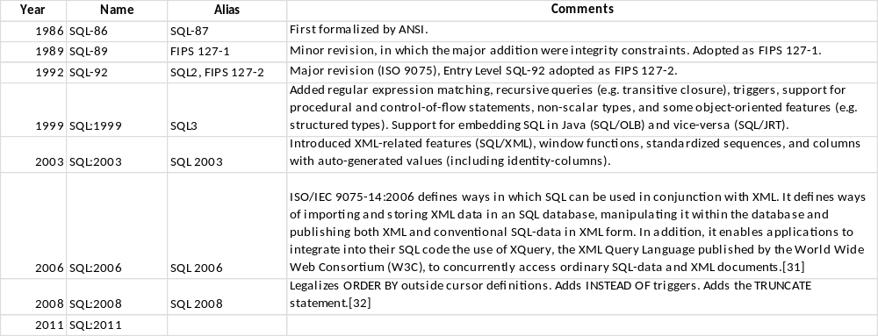
SQL -- Historical Perspective
8/21/2023
COPYRIGHTED BY ARUN SEN

Slide 5
SQL -- Historical Perspective
For SQL Server …
SSIS Tool, Analysis Services Tool, Reporting Services Tool, etc. …
Database Programming Language (DBPL)
Programming Languages (Java, VB, C, C++, …)
OLAP
SQL Server SQL (Transact-SQL) | Oracle 10G SQL (PL-SQL) | DB2 SQL … ACCESS (SQL) …
OLTP
SQL Language
Relational Algebra (invented by Ted Codd in 1973)
Purely, from Tools perspective
8/21/2023
COPYRIGHTED BY ARUN SEN

Slide 6
SQL in Different Roles
Data definition language (DDL):
  allows users to describe the relations and constraints.
Constraint specification language:
  commands to specify constraints ensured by DBMS
Query language:
  relationally complete, supports aggregation and grouping
  declarative -- you specify what you want and not how to retrieve, easy to learn and program
Updates:
  insert, delete, and update tables
View definition language:
  commands to define rules
  updates through views generally not supported
8/21/2023
COPYRIGHTED BY ARUN SEN

Slide 7
SQL in Different Roles (cont)
Embedded SQL:
  has been embedded in a variety of host languages:
    C, C++, PERL, Smalltalk, Java (vendor dependent)
  Impedance mismatch: SQL manipulates relations that are sets/bags --- programming languages do not handle sets/bags as efficiently.
Transaction Control:
  commands to specify beginning and end of transactions.
8/21/2023
COPYRIGHTED BY ARUN SEN

Slide 8
SQL as DDL
CREATE TABLE Dept
(dno int,
dname varchar(30) not null,
mgr char(15)
);
CREATE TABLE emp
(ename char(15) not null,
dno int default 0,
sal int
);
We will cover more constraints later.
Don’t allow null values
Default value is 0
8/21/2023
COPYRIGHTED BY ARUN SEN

Slide 9
Domain types
char(n): fixed length char string
varchar(n): variable-length char string
int or integer
smallint
numeric(p,d): fixed-point number of given precision
real, double precision
float(n): floats with a given precision
date: containing year, month, and date
time: in hours, minutes, and seconds
Null value is part of each domain
8/21/2023
COPYRIGHTED BY ARUN SEN

Slide 10
Define new domains
CREATE DOMAIN personDom CHAR(20);
CREATE TABLE emp
(ename personDom,
dno int default 0,
sal real
);
8/21/2023
COPYRIGHTED BY ARUN SEN

Slide 11
SQL as a Query Language
SELECT A1, A2, …, An
FROM R1, R2, …, Rm
WHERE conditions;
Example: Emp(ename, dno, sal),
Dept(dno, dname, mgr)
Query 1: “Find employees working in department 132.”
  SELECT ename
  FROM Emp
WHERE dno=132;
Query 2: “Find the manager of the ‘sells’ department.”
  SELECT mgr
  FROM Dept
WHERE dname = ’sells’;
8/21/2023
COPYRIGHTED BY ARUN SEN

Slide 12
SQL vs relational algebra
SELECT A1, A2, …, An
FROM R1, R2, …, Rm
WHERE conditions;
Equivalent relational algebra expression:
Π_{A1,…,An} (σ _{cond} (R1 × R2 × … Rm))
Difference:
  Relational algebra uses set semantics
  Most SQL operators uses bag semantics
  However, SQL set operators use set semantics
8/21/2023
COPYRIGHTED BY ARUN SEN

Slide 13
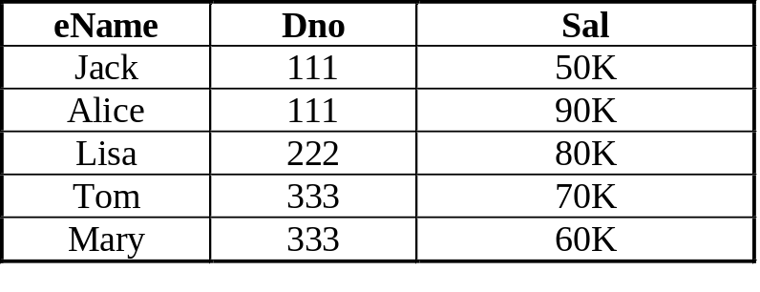
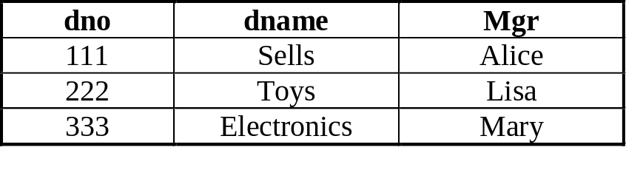
“Select” clause
Specify attributes to project onto (different from the “selection” operator in the relational algebra)
Can use relation prefix (especially when we need to disambiguate attribute names)
Use star * to denote all attributes:
SELECT *
FROM Emp, Dept
WHERE Emp.dno = Dept.dno;
Emp (ename, dno, sal)
Dept(dno, dname, mgr)
8/21/2023
COPYRIGHTED BY ARUN SEN

Slide 14
Eliminate duplicates
“SELECT” does not automatically eliminate duplicates.
  Select dno
  From Emp;
  If there are more than 1 employee in the department 333, then ‘333’ will appear more than once in the result.
Use keyword distinct to explicitly remove duplicates
Select distinct dno
  From Emp;
Emp (ename, dno, sal)
8/21/2023
COPYRIGHTED BY ARUN SEN

Slide 15
“FROM” clause
Specify relations
Renaming relations:
  Use “as” to define “tuple variables,” to disambiguate multiple references to the same relation
  “who makes has higher salary than their manager”
  SELECT E1.ename
  FROM Emp as E1, Dept, Emp as E2
  WHERE E1.dno = Dept.dno AND
  Dept.mgr = E2.ename AND E1.sal > E2.sal;
E1: Emp (ename, dno, sal)
Dept(dno, dname, mgr)
E2: Emp (ename, dno, sal)
8/21/2023
COPYRIGHTED BY ARUN SEN

Slide 16
“WHERE” clause
Specify conditions
Optional
Complicated conditions:
  AND, OR, NOT, …
  “Employees who work for Sally and have a salary < 10K”
  SELECT ename
  FROM Emp, Dept
  WHERE Emp.dno=Dept.dno AND D.mgr = ‘Sally’ AND sal < 10000;
String patterns:
  “s LIKE p”: string s in pattern p
  Percent %: zero, one, or multiple occurrences of any character
    dname LIKE ‘TOM %’
    ‘TOM KERRY’, ‘TOM JOHNSON’ …
  underbar _: one-character wildcard
    dname LIKE ‘a _ c’
    ‘abc’ ‘adc’ ‘azc’ ‘a9c’ …
8/21/2023
COPYRIGHTED BY ARUN SEN

Slide 17
Conditions in a “WHERE” clause
attribute names of the relation(s) used in the FROM.
comparison operators: =, <>, <, >, <=, >=
arithmetic operations: stockprice*2
operations on strings (e.g., “||” for concatenation).
lexicographic order on strings.
pattern matching: s LIKE p
special operations for comparing dates and times.
Use relation prefix to disambiguate attribute names
  SELECT ename, dname, dept.dno
  FROM Emp, Dept
  WHERE Emp.dno = Dept.dno;
8/21/2023
COPYRIGHTED BY ARUN SEN

Slide 18
Ordering output tuples
select *
from Emp
order by dno, sal desc, ename;
Order the tuples by dno. Within each dept, order salaries from highest to lowest. For salary ties, use alphabetical order on the name.
    ename dno sal location
    Mary 1 30K Irvine
    Susan 1 30K Irvine
    Jane 1 19K Irvine
    Jim 2 15K LA
    John 2 15K LA
8/21/2023
COPYRIGHTED BY ARUN SEN

Slide 19
Set Operations
Use the set semantics
Union: ∪. “Find names of people who are managers of either the toy or the sells department.”
  (select mgr from D where dname=‘toy’)
  union
  (select mgr from D where dname = ‘sells’);
Intersect: ∩. (It is not available in SQL Server!!!!)
(select mgr from D where dname=‘toy’)
  intersect
  (select mgr from D where dname = ‘sells’);
Except: -.
(select mgr from D where dname=‘toy’)
  except
  (select mgr from D where dname = ‘sells’);
8/21/2023
COPYRIGHTED BY ARUN SEN

Slide 20
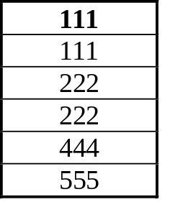
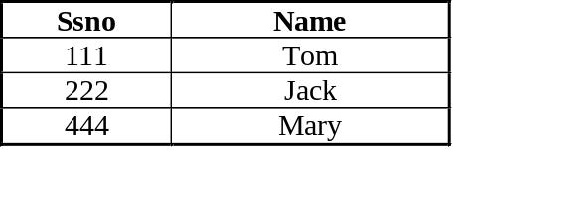
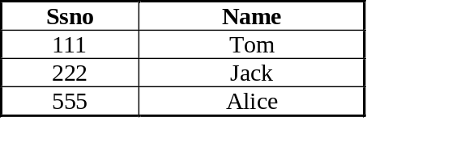
Conserving Duplicates
The UNION, INTERSECT, and EXCEPT operators use the set semantics, not bag semantics.
To keep duplicates, use “ALL” after the operators:
  UNION ALL, INTERSECT ALL, EXCEPT ALL
  Example:
(SELECT ssno FROM student)
UNION ALL
(SELECT ssno FROM ta);
Student (ssno, name)
TA (ssno, name)
Result
8/21/2023
COPYRIGHTED BY ARUN SEN

Slide 21
Unintuitive SQL query
Relations: R(A), S(A), T(A)
Query: “R ∩ (S ∪ T)”
SELECT R.A
FROM R, S, T
WHERE R.A=S.A OR R.A=T.A;
But what happens if T is empty?
  The SQL result becomes empty
  Be careful when you translate a relational algebra expression to SQL
R
S
T
8/21/2023
COPYRIGHTED BY ARUN SEN

Slide 22
Right solutions
R ∩ (S ∪ T)
(SELECT R.A FROM R)
intersect (SELECT S.A FROM S)
union
(SELECT T.A FROM T));
(SELECT R.A FROM R, S WHERE R.A=S.A)
union
(SELECT R.A FROM R, T WHERE R.A=T.A);
8/21/2023
COPYRIGHTED BY ARUN SEN

Slide 23
Aggregations
MIN, MAX, SUM, COUNT, AVG
  input: collection of numbers/strings (depending on operation)
  output: relation with a single attribute with a single row
Example: “What is the minimum, maximum, average salary of employees in the toy department”
  select min(sal), max(sal), avg(sal)
    from Emp, Dept
    where Emp.dno = Dept.dno and D.dname = ’Toy’;
8/21/2023
COPYRIGHTED BY ARUN SEN

Slide 24
Aggregations (cont)
Except “count,” all aggregations apply to a single attribute
“Count” can be used on more than one attribute, even “*”
SELECT Count(*) FROM Emp;
SELECT Count(ename) FROM Emp;
Emp (ename, dno, sal)
8/21/2023
COPYRIGHTED BY ARUN SEN

Slide 25
Duplication in aggregations
“What is the number of different dno’s in the emp table”
  Select count(dno)
  From Emp;
Wrong, since there could be duplicates.
Right query:
  Select count(DISTINCT dno)
  From Emp;
Emp
8/21/2023
COPYRIGHTED BY ARUN SEN

Slide 26
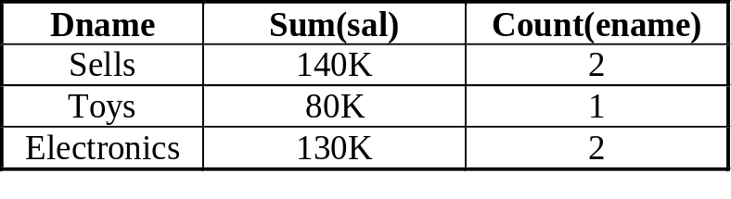
Group By clause
Group by used to apply aggregate function to a group of sets of tuples. Aggregate applied to each group separately.
Example: For each department, list its total number of employees and total salary
  select dname, sum(sal), count(ename)
  from Emp, Dept
  where Emp.dno = Dept.dno
  group by dname;
Emp (ename, dno, sal)
Dept(dno, dname, mgr)
Results
8/21/2023
COPYRIGHTED BY ARUN SEN

Slide 27
Group By clause (cont)
Group-by attributes must be in the “SELECT” attributes.
The following query cannot group the tuples.
select dname, sum(sal), count(ename)
from Emp, Dept
where Emp.dno = Dept.dno;
Emp (ename, dno, sal)
Dept(dno, dname, mgr)
Result (on Informix): “The column (dname) must be in the GROUP BY list.”
8/21/2023
COPYRIGHTED BY ARUN SEN

Slide 28
Group By clause (cont)
The following query:
  SELECT dno FROM Emp
  GROUP BY dno;
  is the same as:
  SELECT DISTINCT dno
  FROM Emp;
8/21/2023
COPYRIGHTED BY ARUN SEN

Slide 29
Having Clause
Having clause used along with group by clause to select some groups.
Predicate in having clause applied after the formation of groups.
“List the department name and the number of employees in the department for all departments with more than 1 employee.”
select dname, count(*)
    from Emp, Dept
    where Emp.dno = Dept.dno
    group by dname
    having count(*) > 1;
Emp (ename, dno, sal)
Dept(dno, dname, mgr)
8/21/2023
COPYRIGHTED BY ARUN SEN

Slide 30
A general SQL query
For each employee in two or more depts, print the total salary of his or her managers. Assume each dept has one manager.
select e1.ename, sum(e2.sal) -- 5
from Emp e1, Dept, Emp e2 -- 1
where e1.dno = Dept.dno AND e2.ename = Dept.mgr -- 2
group by e1.ename -- 3
having count(*) > 1 -- 4
order by ename; -- 6
E1: Emp (ename, dno, sal)
Dept(dno, dname, mgr)
E2: Emp (ename, dno, sal)
8/21/2023
COPYRIGHTED BY ARUN SEN

Slide 31
A general SQL query (cont)
For each employee in two or more depts, print the total salary of his or her managers. Assume each dept has one manager.
select e1.ename, sum(e2.sal) -- 5
from Emp e1, Dept, Emp e2 -- 1
where e1.dno = Dept.dno AND e2.ename = Dept.mgr -- 2
group by e1.ename -- 3
having count(*) > 1 -- 4
order by ename; -- 6
  Execution steps:
  Step 1: tuples are formed (Cartesian product)
  Step 2: tuples satisfying the conditions are chosen
  Step 3: groups are formed
  Step 4: groups are eliminated using “Having”
  Step 5: the aggregates are computed for the select line, flattening the groups
  Step 6: the output tuples are ordered and printed out.
8/21/2023
COPYRIGHTED BY ARUN SEN

Slide 32
Subqueries
Also called nested query. Embedded inside an outer query.
Similar to function calls in programming languages.
Example: Who is in Sally’s department?
  select E1.ename
    from Emp E1, Emp E2
    where E2.ename = ‘Sally’ AND E1.dno = E2.dno;
  OR:
  select ename
    from Emp
    where Emp.dno in
      (select dno
      from Emp → subquery
      where ename = ‘Sally’); → names are scoped
Semantics:
  A nested query returns a relation containing dno for which Sally works
  for each tuple in Emp, evaluate the nested query and check if E.dno appears in the set of dno’s returned by nested query.
8/21/2023
COPYRIGHTED BY ARUN SEN

Slide 33
Conditions involving relations
Usually subqueries produce a relation as an answer.
Conditions involving relations:
  s > ALL R -- s is greater than every value in unary relation R
  s IN R -- s is equal to one of the values in R
  s > ANY R, s > SOME R -- s is greater than at least 1 element in unary relation R.
    any is a synonym of some in SQL
  EXISTS R -- R is not empty.
  Other operators (<, = , <=, >=, <>) could be used instead of >.
  EXISTS, ALL, ANY can be negated.
8/21/2023
COPYRIGHTED BY ARUN SEN

Slide 34
Example 1
Find the employees with the highest salary.
SELECT ename
    FROM emp
    WHERE sal >= ALL (select sal from Emp);
< all, <= all, >= all, = all, <> all also permitted
8/21/2023
COPYRIGHTED BY ARUN SEN

Slide 35
Example 2
Who makes more than someone in the Toy department?
  SELECT ename FROM Emp
  WHERE sal > SOME
      (SELECT sal FROM Emp, Dept
      WHERE Emp.dno = Dept.dno AND Dept.dname = ‘Toy’);
“< some, <= some, >= some, > some =some, <> some” are permitted
8/21/2023
COPYRIGHTED BY ARUN SEN

Slide 36
Testing Empty Relations
“Exists” checks for nonempty set
Find employees who make more money than some manager
SELECT ename
FROM Emp E1
WHERE exists
(SELECT ename
FROM Emp, Dept
WHERE (Emp.ename = Dept.mgr)
AND (E1.sal > Emp.sal));
E1: Emp(ename, dno, sal)
Dept(dno, dname, mgr)
Emp (ename, dno, sal)
8/21/2023
COPYRIGHTED BY ARUN SEN

Slide 37
Testing Empty Relations (cont)
The nested query uses attributes name of E1 defined in outer query. These two queries are called correlated.
  Semantics: for each assignment of a value to some term in the subquery that comes from a tuple variable outside, the subquery needs to be executed
  Clearly the database can do a much better job
Similarly, “NOT EXISTS” can be used.
8/21/2023
COPYRIGHTED BY ARUN SEN

Slide 38
Subqueries producing one value
Sometimes subqueries produce a single value
select ename
    from Emp
    where Emp.dno =
      (select dno
      from dept
      where dname = ‘toy’);
Assume there is only one department called “toy,” then the subquery returns one value.
If it returns more, it’s a run-time error.
8/21/2023
COPYRIGHTED BY ARUN SEN

Slide 39
Joins
Expressed implicitly using SELECT-FROM-WHERE clause.
Alternatively, joins can be expressed using join expressions.
Different vendors might have different implementations.
8/21/2023
COPYRIGHTED BY ARUN SEN

Slide 40
Cross Join
“CROSS JOIN”: Emp(ename, dno, sal), Dept(dno, dname, mgr)
  emp CROSS JOIN dept;
  Result is a Cartesian product. A relation with 6 attributes.
“JOIN … ON”:
  SELECT emp.ename, dept.dname
  FROM emp JOIN dept
  ON emp.dno = dept.dno;
  After the Cartesian product, “emp.dno = dept.dno” is applied.
  Result has two attributes.
  emp JOIN dept ON emp.dno = dept.dno; 6 attributes in results.
8/21/2023
COPYRIGHTED BY ARUN SEN

Slide 41
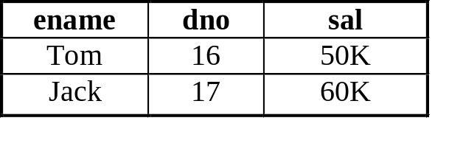
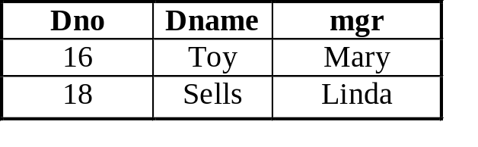
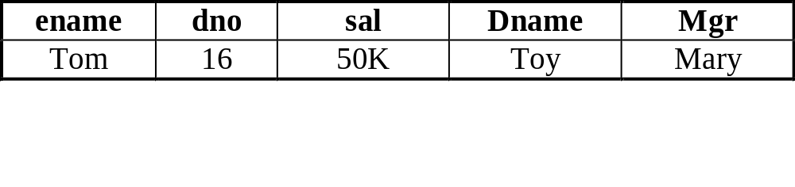
Natural Joins
  emp NATURAL JOIN dept;
  Produces a relation with 5 attributes. Equivalent to:
  SELECT ename, emp.dno, sal, dname, mgr
  FROM emp CROSS JOIN dept ON emp.dno = dept.dno;
Result
8/21/2023
COPYRIGHTED BY ARUN SEN

Slide 42
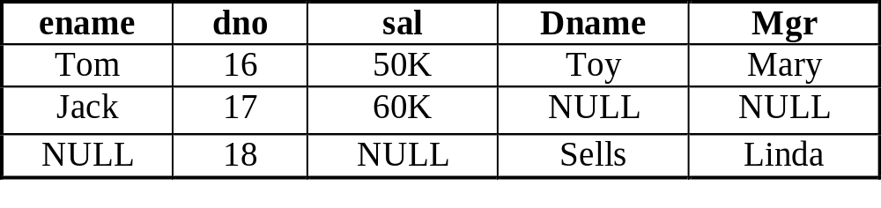
Natural Full Outer Joins
emp NATURAL FULL OUTER JOIN dept;
A relation with 5 attributes. Pad NULL values to both relations.
Result
8/21/2023
COPYRIGHTED BY ARUN SEN

Slide 43
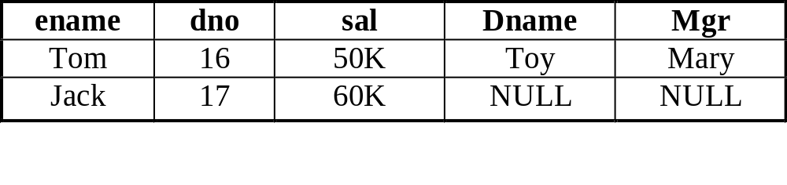
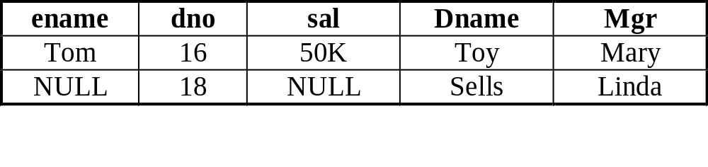
Natural Left/Right Outer Joins
emp NATURAL LEFT OUTER JOIN dept;
A relation with 5 attributes. Pad NULL values to dangling tuples of emp.
emp NATURAL RIGHT OUTER JOIN dept;
A relation with 5 attributes. Pad NULL values to dangling tuples of dept.
8/21/2023
COPYRIGHTED BY ARUN SEN

Slide 44
Outer Join on different attributes
FULL OUTER JOIN ON <condition>
Useful when two relations have different attribute names
“ON <cond>” must exist
Example: student(sid, dno), dept(dept#, chair)
student FULL OUTER JOIN dept
ON student.dno = dept.dept#; → different attribute names
Similarly, we have:
  LEFT OUTER JOIN ON <condition>
  RIGHT OUTER JOIN ON <condition>
8/21/2023
COPYRIGHTED BY ARUN SEN

Slide 45
Join Summary
R CROSS JOIN S;
R JOIN S ON <condition>;
R NATURAL JOIN S
R NATURAL FULL OUTER JOIN S
R NATURAL LEFT OUTER JOIN S
R NATURAL RIGHT OUTER JOIN S
R FULL OUTER JOIN S ON <condition>
R LEFT OUTER JOIN S ON <condition>
R RIGHT OUTER JOIN S ON <condition>
Again: Different vendors might have different implementations.
8/21/2023
COPYRIGHTED BY ARUN SEN

Slide 46
Database Modifications
Insert
Delete
Update
8/21/2023
COPYRIGHTED BY ARUN SEN

Slide 47
Insertion of a tuple
INSERT INTO R(A1,…,An) VALUES (v1,…,vn)
Example:
INSERT INTO Emp (ename, dno, sal)
VALUES (’Tom’, 123, 45000)
Can drop attribute names if we provide all of them in order.
INSERT INTO Emp
VALUES (’Tom’, 123, 45000)
If we don’t provide all attributes, they will be filled with NULL.
INSERT INTO Emp (ename,sal)
VALUES (‘Tom’, 45000)
8/21/2023
COPYRIGHTED BY ARUN SEN

Slide 48
Insertion of a query’s result
INSERT INTO relation (subquery);
CREATE TABLE LowIncomeEmp(ename char(12),
dno int,
sal float);
INSERT INTO LowIncomeEmp
( SELECT *
FROM emp
WHERE sal <= 30K AND dno = 123;
);
INSERT INTO LowIncomeEmp
( SELECT ename, dno, sal * 1.1 → salary increased by 10%
FROM emp
WHERE sal <= 30K AND dno = 123;
);
Note the order of querying and inserting: subquery first.
8/21/2023
COPYRIGHTED BY ARUN SEN

Slide 49
Delete
DELETE FROM relation [WHERE conditions];
Example:
DELETE
FROM emp
WHERE dno = 123;
DELETE
FROM emp; → all tuples will be deleted
There is no way to delete only a single occurrence of a tuple that appears twice in a relation.
8/21/2023
COPYRIGHTED BY ARUN SEN

Slide 50
Delete (cont)
Delete all employees working in a department with only one employee.
DELETE
FROM emp AS E1
WHERE NOT EXISTS
(SELECT ename
FROM emp
WHERE dno = E1.dno AND ename <> E1.ename);
Note the relation renaming “E1”
8/21/2023
COPYRIGHTED BY ARUN SEN

Slide 51
Update
UPDATE relation SET assignments WHERE condition
“Change employees in dept 123 to dept 345.”
UPDATE emp
SET dno = 345
WHERE dno = 123;
“Cut the salaries that are more than 100K by 10%.”
UPDATE emp
SET sal = sal * 0.9
WHERE sal > 100000;
Multiple assignments separated by “,”
UPDATE emp
SET dno = 345, sal = sal * 1.1
WHERE dno = 123;
8/21/2023
COPYRIGHTED BY ARUN SEN

Slide 52
SQL Constraints
8/21/2023
COPYRIGHTED BY ARUN SEN

Slide 53
Schema Definition
CREATE TABLE r (
  A1 D1 [not null] [default V1]
  …
  An Dn [not null] [default Vn]
  <integrity constraint 1>
  …
  <integrity constraint k>
)
Each integrity constraints could be:
  primary key
  candidate key
  foreign key
  “check(predicate)”: specifies predicate to be satisfied by each tuple
8/21/2023
COPYRIGHTED BY ARUN SEN

Slide 54
Declaring Keys
PRIMARY KEY or UNIQUE
CREATE TABLE emp
( ssn int Primary Key,
name char(15),
dno int,
);
CREATE TABLE emp
( ssn int,
name char(15),
dno int,
Primary Key (ssn)
);
CREATE TABLE emp
( ssn int,
name char(15),
dno int,
Primary Key (dno,name)
);
Multiple attributes
8/21/2023
COPYRIGHTED BY ARUN SEN

Slide 55
Enforcing Key Constraints
Check constraint each time the table is modified
  Insertion: check
  Update: check
  Deletion: do not check
Enforcing key constraints efficiently:
  Suppose “ssn” is a primary key of Emp.
  Every time we insert a new employee, do we want to scan the whole table to check if the ssn already exists? No!
  Using index on the key attribute(s).
8/21/2023
COPYRIGHTED BY ARUN SEN

Slide 56
Foreign-Key Examples
Emp (ename, dno, sal)
CREATE TABLE emp
( ssn int,
name char(15),
dno int REFERENCES dept(dept#),
);
CREATE TABLE emp
( ssn int,
name char(15),
dno int,
FOREIGN KEY dno REFERENCES dept(dept#));
Dept(dno, dname, mgr)
Allow multiple attributes in one foreign-key constraint.
Allow multiple foreign-key constraints in one table.
8/21/2023
COPYRIGHTED BY ARUN SEN

Slide 57
Foreign-key Constraints
Also called “referential integrity”
Within an attribute:
  REFERENCES <TABLE> (<attributes>)
Separate declaration:
  FOREIGN KEY <attributes> REFERENCES <table> (<attributes>)
If R.A references S.B, then S.B must be a primary key.
NULL values allowed for attributes in a foreign key.
  A foreign-key constraint is automatically satisfied if even one attribute in the foreign key is null.
8/21/2023
COPYRIGHTED BY ARUN SEN

Slide 58
Enforcing Foreign-Key Constraints
Emp (ename, dno, sal)
Dept(dno, dname, mgr)
Emp.dno references Dept.dept#
Modification (insert, update) of Emp
  If the new tuple’s dno does not exist in Dept.dno , then REJECT!
8/21/2023
COPYRIGHTED BY ARUN SEN

Slide 59
Enforcing Foreign-Key Constraints
Emp (ename, dno, sal)
Dept(dno, dname, mgr)
Emp.dno references Dept.dept#
Modification (delete, update) of Dept whose old “dno” is referenced by a record in Emp. There are 3 strategies:
  Default: reject
  Cascade: change the Emp tuple correspondingly
    Delete in Dept: delete the referring record(s) in Emp
    Update in Dept: update the dno of the referring record(s) in Emp to the new dno
  Set Null: change dno value in referring record(s) in Emp to NULL
8/21/2023
COPYRIGHTED BY ARUN SEN

Slide 60
Choosing a Policy
Add “ON [DELETE,UPDATE] [CASCADE, SET NULL]” when declaring a foreign key
Which policy to choose depends on the application.
CREATE TABLE emp
( ssn int,
name char(15),
dno int,
FOREIGN KEY dno REFERENCES
dept(dept#)
ON DELETE SET NULL
ON UPDATE CASCADE
);
8/21/2023
COPYRIGHTED BY ARUN SEN

Slide 61
SQL – Things we have discussed so far ….
Preliminary SQL
  DDL Commands
    CREATE TABLE, CREATE INDEX, ALTR TABLE, …
    DROP TABLE
    CREATE INDEX
    Etc.
  DML Commands
    INSERT (many kinds)
    UPDATE
    DELETE
    Etc.
  Retrieval Commands
    SELECT (many kinds)
    Inner Join and Outer Join
    Subqueries
    Grouping
8/21/2023
COPYRIGHTED BY ARUN SEN

